Slide 1


UKG/Kronos Timekeeping System
A Refresher for Community College of Philadelphia Managers
Try installing Poppins in template via desktop PPT
How to make custom frame: insert picture > go to "Crop" and click "crop to shape" > crop again to adjust shape itself but make sure picture is not stretched/compromised

Slide 2


Topics Covered
Getting Started
View Your Team
View Your Employees’ Timesheets
Approve Timesheets and Time Off Requests
Make Timesheet Changes
Apply a Work Schedule
Time and Attendance Reporting
Workflow Delegations
Best Practices
PTO Eligibility
Resources and Support

Slide 3
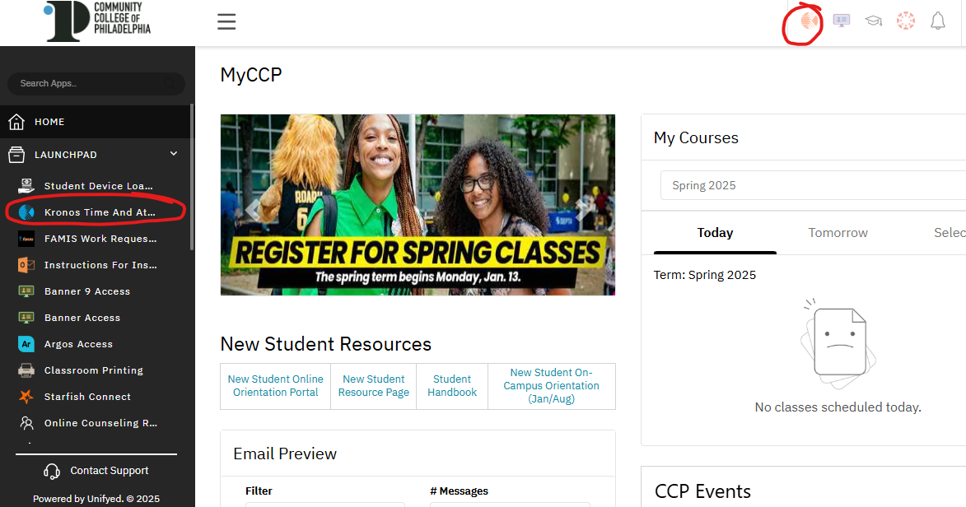
Getting Started With Kronos
To access Kronos:
Log in to MyCCP
Navigate to the Kronos icon on the top right corner
Or, navigate to the menu on the left side of your MyCCP homepage
Click the Launchpad dropdown
Select Kronos Time and Attendance

Slide 4
View Your Team
On your dashboard, go to the menu in the left corner
  Click the Team tab at the top
  Click My Team on the left
  Click Team Members

Slide 5
View Your Team
This will bring you to a page displaying all of your employees
To go to an employee’s profile, simply click on their name
You can also click this icon to the left of the employee’s name to open up a Quick Links menu, where you can choose to go directly to all timesheets, current timesheet, availability, schedule, or request time off

Slide 6
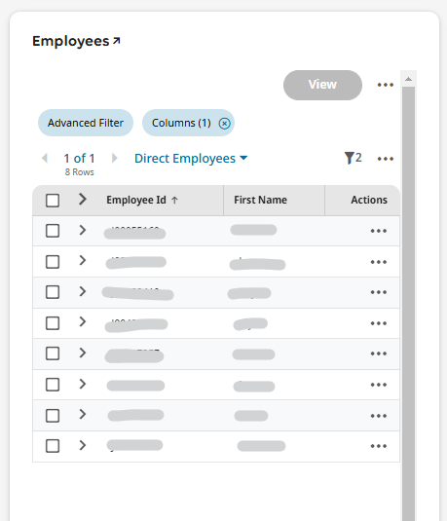
View Your Team
You can also access a list of your employees by going to the Employees widget on your Kronos homepage
You can use the filter option to sort your employees

Slide 7
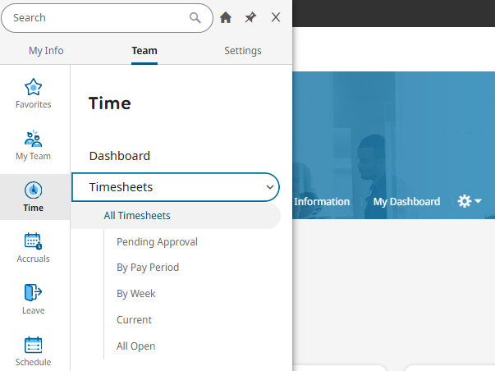
View Your Employees Timesheets
There a few different ways to view your employees’ timesheets
To view in list form, navigate to the menu at the top left of the dashboard
  Click the Team tab at the top
  Click the Time tab on the left
  Click Timesheets>All Timesheets

Slide 8
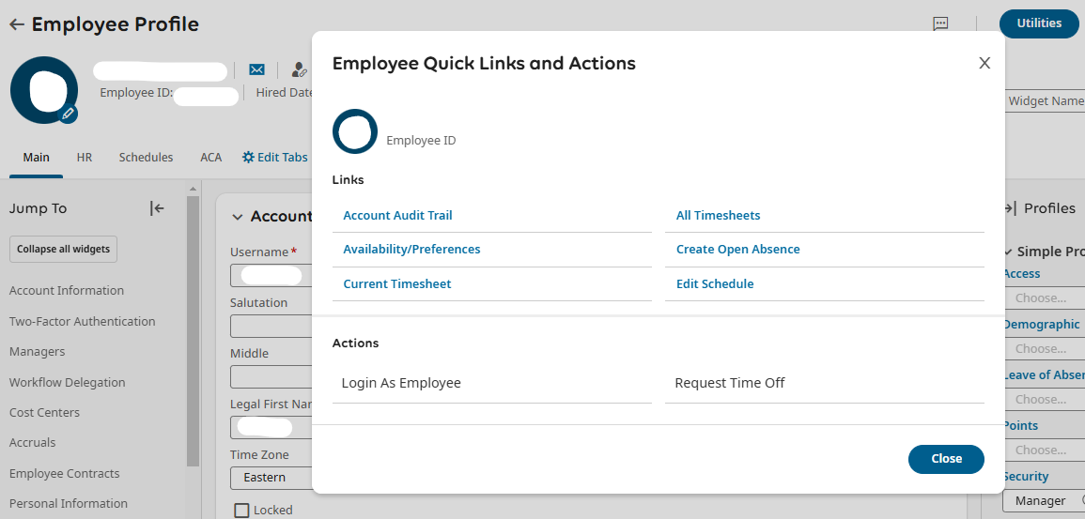
View Your Employees Timesheets
You can also view an employee’s individual timesheet by clicking the employee’s name in your team view and opening the Employee Quick Links menu
You can also click the employee’s name to go to their profile
  Once there, click the Utilities button at the right
  Click Current Timesheet

Slide 9
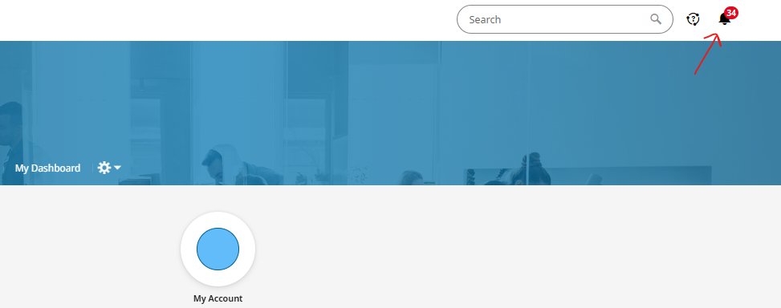
Approve Timesheets
On your UKG dashboard, navigate to the top right of the screen and click on the bell icon
This will bring you to your To Do Items and Notifications

Slide 10
Approve Timesheets and Time Off Requests
Once on this page, your To Do Items will appear in list form on the left of the screen with a detailed view of each item on the right
You can use the checkboxes on the left to select multiple items you wish to reject or approve and then click Reject or Approve on the top right

Slide 11
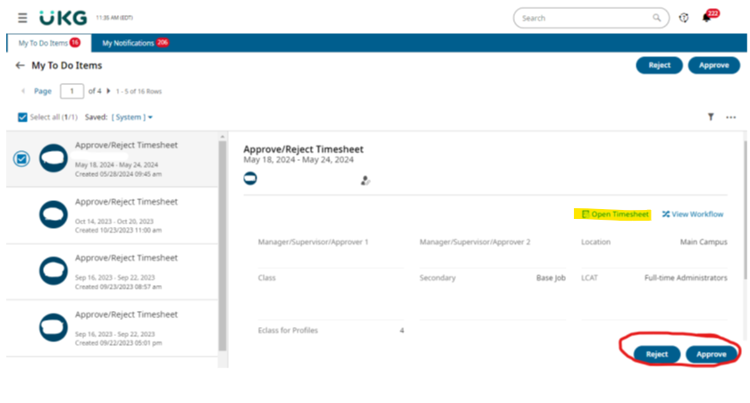
Approve Timesheets and Time Off Requests
Or, you can approve or reject each item individually by using the Reject or Approve buttons on the bottom right of the detailed view
You can also navigate to the employee’s timesheet by clicking Open Timesheet in the detailed view of the To Do item
Please note: you should always view your employee’s timesheet before approving to make sure it is correct

Slide 12
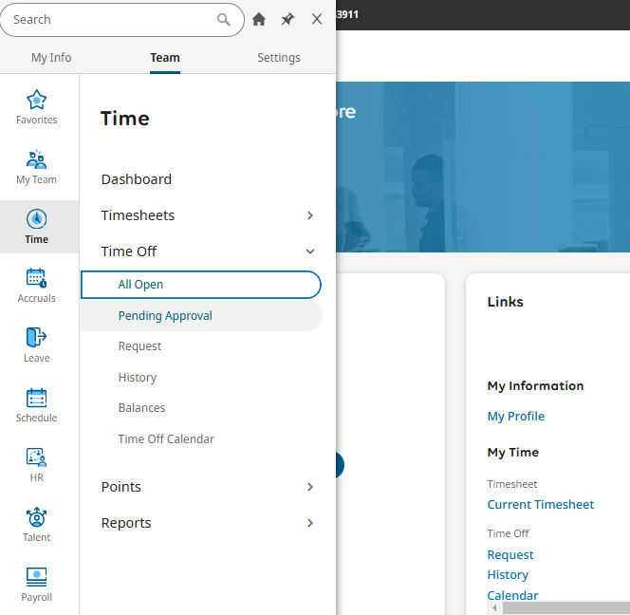
Approve/Reject Time Off Requests
If you wish to view a list of all your employees’ time off requests, go to the menu on your dashboard
Click the Team tab at the top
Click the Time tab on the left
Click Time Off>Pending Approval

Slide 13
Make Timesheet Changes- Edit Clock In/Out Times
Once on the desired timesheet, find the correct day
Edit the clock in and/or out times in the From and To fields
Once you’ve entered the new time(s), click Save at the top right of the timesheet
Please Note: only hourly employees need clock in and out times on their timesheet

Slide 14
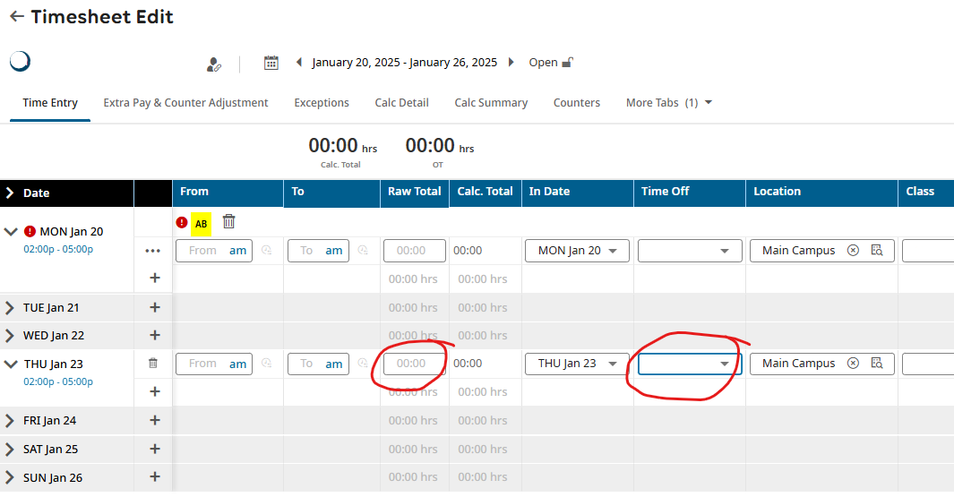
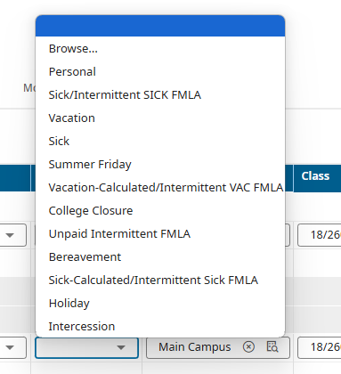
Make Timesheet Changes- Edit/Add/Delete Time Off
Once on the desired timesheet, find the correct day and enter/update the amount of hours
Then click arrow in the Time Off field and choose the type of time off from the drop down menu
Click Save at the top right of the timesheet
If the employee does not have the time available, you will receive an error message

Slide 15
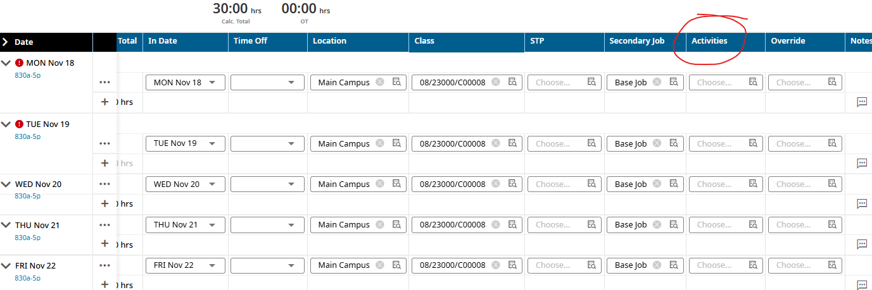
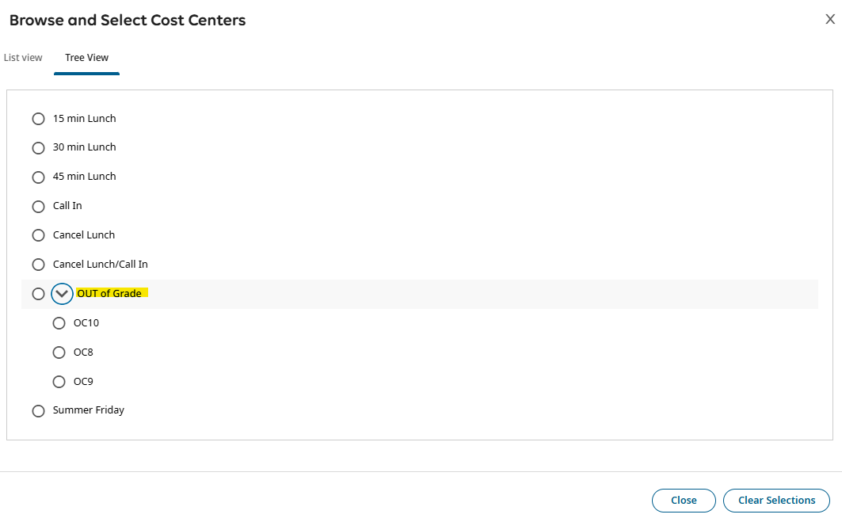
Make Timesheet Changes- Out of Grade
Find the day on the timesheet and scroll all the way to the right to Activities
Click Out of Grade and then select which to use
Out of grade pay is determined based on how many grades difference there is between the employee’s primary job and the job that they’re doing temporarily:
  1 grade = 8% bump = OC8
  2 grades = 9% bump = OC9
  3 grades = 10% bump = OC10

Slide 16
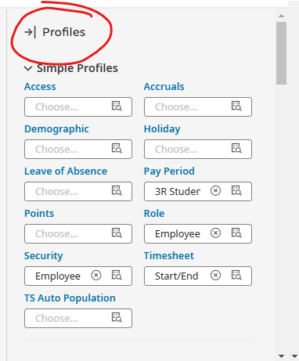
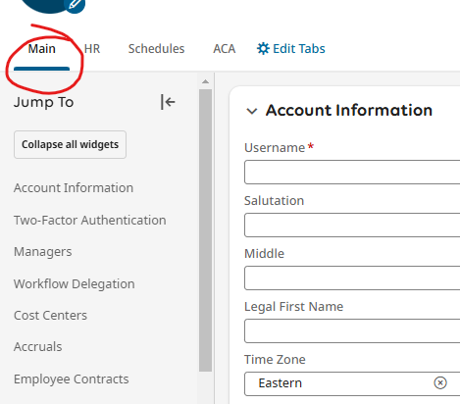
Apply a Work Schedule
To apply a work schedule, navigate to the employee’s profile by typing their name in the search bar or by accessing the quick links menu next to their name on the My Team page
Once on their profile, make sure you are on the Main tab
Navigate to the Profiles menu on the right side of the screen

Slide 17
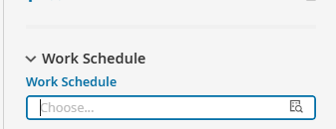
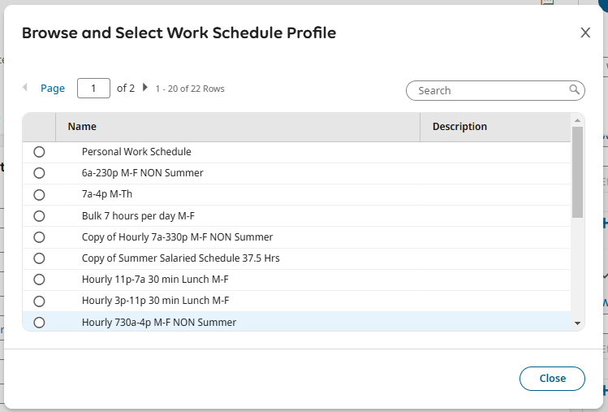
Apply a Work Schedule
Scroll all the way to the bottom of the Profiles menu to Work Schedule
By clicking the magnifying glass icon, you can choose from existing work schedule profiles or you can apply a Personal Work Schedule
If you choose an existing work schedule profile, scroll to the top of the employee’s profile and click Save
If you choose a Personal Work Schedule, once you select it from the list, click Save at the top of the employee profile and then scroll back down to Work Schedules and click Edit

Slide 18
Create a Personal Work Schedule
Here you can personalize the employee’s schedule
You can choose from existing schedule templates in the drop down under TYPE
Or you can select custom start and end times using the Fixed template then typing in the start time and the end time for each day
Please note - schedule information should be entered for every day of the week that the employee will work

Slide 19
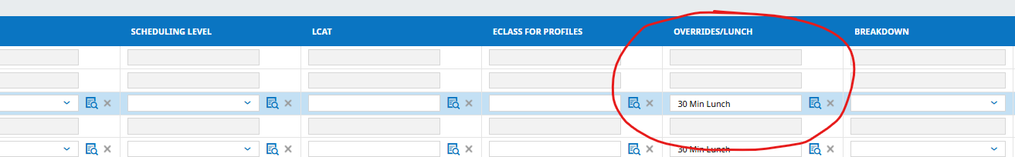
Create a Personal Work Schedule
If lunch will not be the standard 1 hour, you can choose to override by clicking the magnifying glass icon under the Overrides/Lunch column and selecting the desired override
Once done creating the schedule, click SAVE at the top right of the page
You will receive a warning message; click Save again

Slide 20
Apply a Work Schedule- Generate Schedule
To load the schedule to the employee’s timesheets, search and click Generate Schedules.
FYI: Schedules push to timesheets on a regular basis, up to 2 weeks in advance. This step will override the old entries.
Check the box next to the employee’s name
Click the Generate Schedules button at the top right

Slide 21
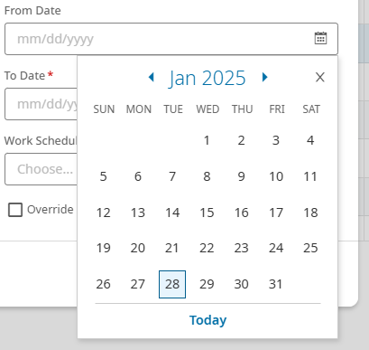
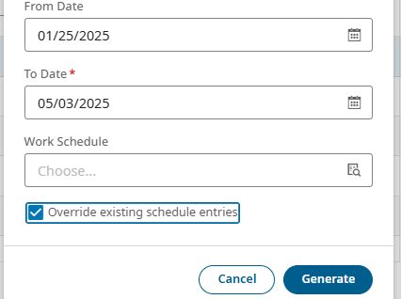
Apply a Work Schedule- Generate Schedule
Next, select the date range for the work schedule
Leave Work Schedule blank and check the Override existing schedule entries box
Click Generate
Click OK
Navigate to the employee’s timesheet to verify that the schedule properly loaded into their timesheet

Slide 22
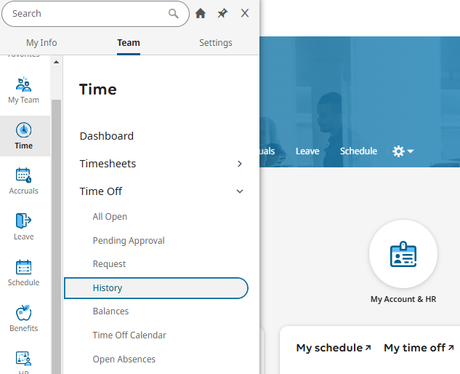
Time and Attendance Reporting
To view a list of your employees time off, go to the menu
Click the Team tab at the top
Click the Time tab on the left
Click Time Off>History

Slide 23
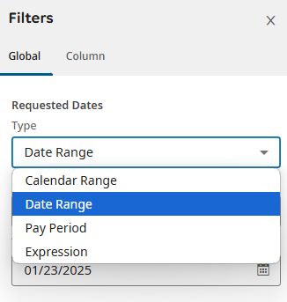
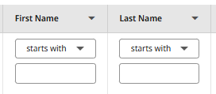

Time and Attendance Reporting
This will bring you to a list of all your employees’ time off
You can use the filters on the top of the report to look for a specific employee
You can also adjust the date range by clicking the funnel icon at the top right of the report, selecting/entering your date range, and clicking Apply at the bottom

Slide 24
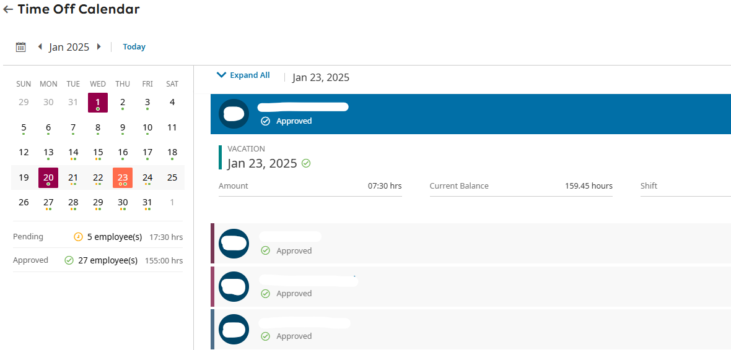
Time and Attendance Reporting
You can also view your employees’ time off in calendar format by going to the menu
Click the Team tab at the top
Click the Time tab on the left
Time Off>Time Off Calendar
There you will see a calendar on the left with all time off and a detailed view on the right with time off information for each day

Slide 25
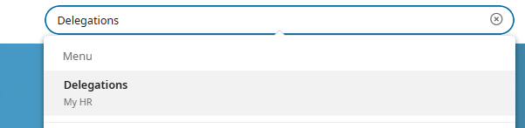
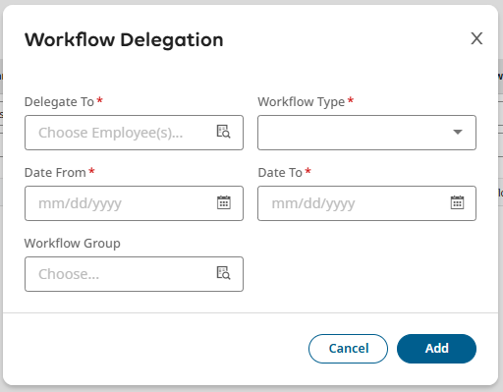
Workflow Delegations
If you are going on LOA or taking extended time off and need to delegate tasks such as approving timesheets, you can set up a Workflow Delegation
Go to the search bar, enter and click Delegations
Once there, click Add New in the top right corner
Then enter the details of the delegation (who will receive them, what workflows to send, and when) and click Add

Slide 26
Best Practices
Keep up with your To Do Items and Notifications
Submit and Approve your employees timesheets every Monday by 10 am
Make sure to review your employees’ timesheets before approving them
Make sure your employees Work Schedule Profile is up to date (i.e., Summer Schedule change)

Slide 27
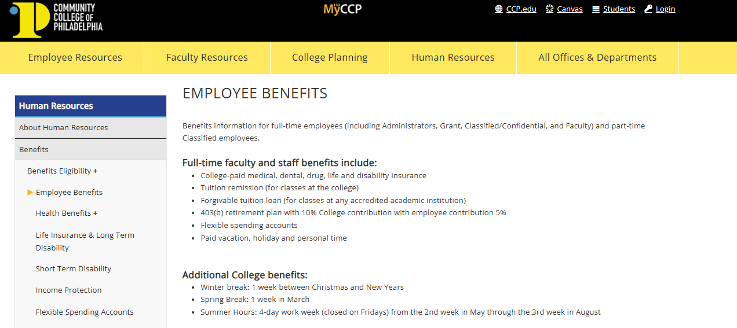
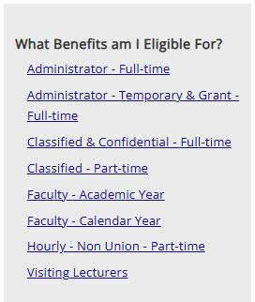
PTO Eligibility
For more information on PTO policies and other benefits eligibility information:
Visit the Employee Benefits page on the college website
Select your employee classification

Slide 28
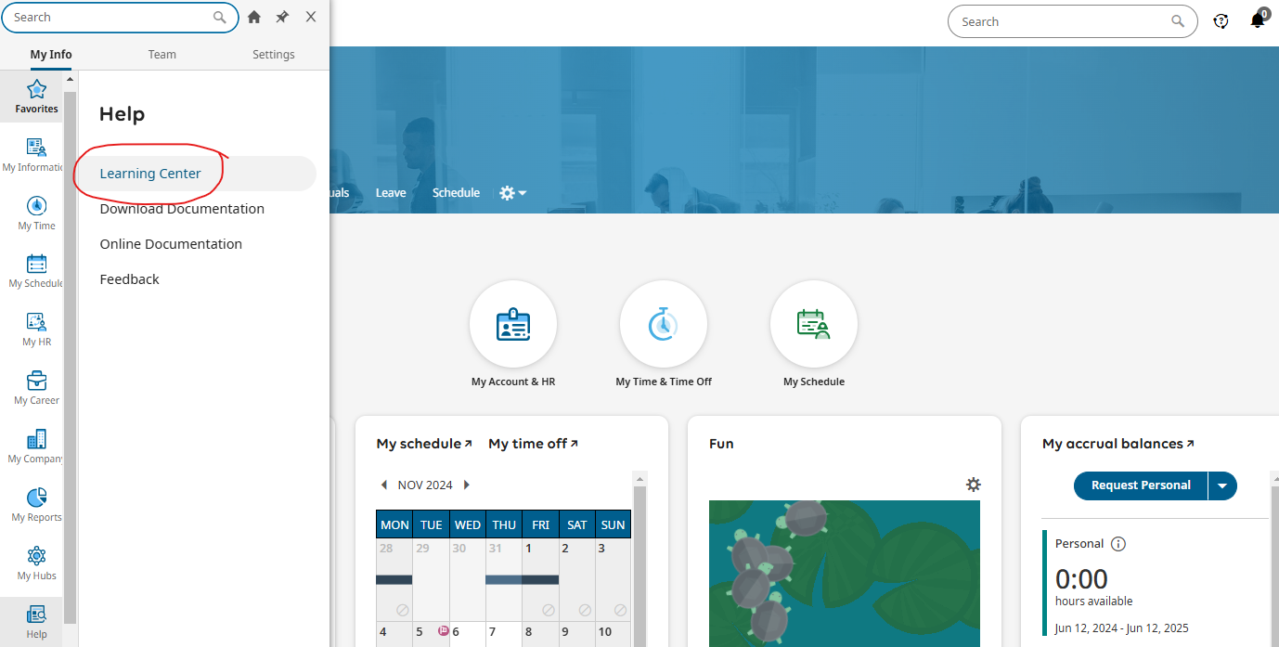
Resources and Support
For resources and training materials:
Visit the Learning Center located in the menu on your Kronos dashboard by clicking the Help tab, then Learning Center
Visit the Time and Attendance Training Materials page on the college website
For other Kronos related questions, please contact Kronos@ccp.edu

Slide 29
Thank you for attending this Webinar!

